Slide 1


HOUSE SELECTION USING AHP & TOPSIS, RIYAHD
Sami Alharbi 201448140
Mohammed AL Sulayyim 201766890

Slide 2
OUTLINE
INTRODUCTION
METHODOLOGY
DATA COLLECTION
EXCLUSION CRITERIA
CALCULATIONS
CONCULSION

Slide 3
INTRODUCTION
Most investment decisions involve the assessment of both qualitative and quantitative decisions including evaluation of a complex set of interplay among these factors. .
The house selection process exemplifies the type of investment decision where much of the evaluation is qualitative. The prospective house buyer faces the daunting task of evaluating a large and diverse array of information before being able to reach a rational decision.

Slide 4
INTRODUCTION
This project presents the house selection process for certain buyer in Riyadh using the Analytic Hierarchy Process (AHP) and Technique for Order of Preference by Similarity to Ideal Solution (TOPSIS).

Slide 5
METHODOLOGY
Analytic Hierarchy Process (AHP):
The AHP helps to break down the problem into small parts. First, construct the problem into a structured hierarchy, then put in place a matrix of analysis in pairs to evaluate the importance of each one. Then, compare the two branches of the same level two by two, by assigning an encrypted note (predefined scale, from 1 to 9) to the way we feel the difference between the two criteria. Then, creating a scale of values to fill a matrix of judgments “A”.

Slide 6
METHODOLOGY
TOPSIS:
The TOPSIS is used to calculate all the above steps and obtains the expected results by calculating the weigh through AHP model. First, define numerical values of the levels to be assigned to each alternative. These values will be used to measure both positive and negative criteria. Each weighting criterion is assigned a weighting. The weights calculated using AHP. After all, the scores of the matrix of the given levels are normalized to the criteria r_{ij}.

Slide 7
DATA COLLACTION
Set of houses has been considered in this project. The data collected are shown several information about the house:
Cost
Size
Number of rooms
Number of bathrooms
Location

Slide 8
EXCLUSION CRITERIA
 | HOUSE9 | HOUSE7 | HOUSE2 | HOUSE1
PRICE | 1850000 | 1790000 | 1750000 | 1500000
# OF ROOMS | 6 | 7 | 6 | 5
# OF BATHROOMS | 6 | 5 | 4 | 4
SPACE | 570 | 510 | 360 | 337
LOCATION | Alqirwan | Alyasimin | Almunsia | Alearid
The four exclusion criteria were chosen based on buyer preferences
Price is less than 1900000 SR
Space above 300 m^2
Location in north Riyadh
Number of rooms 5 or above
Number of bathrooms 4 or above
Appling the above exclusion criteria we were able to narrowed down the number of houses to 4

Slide 9
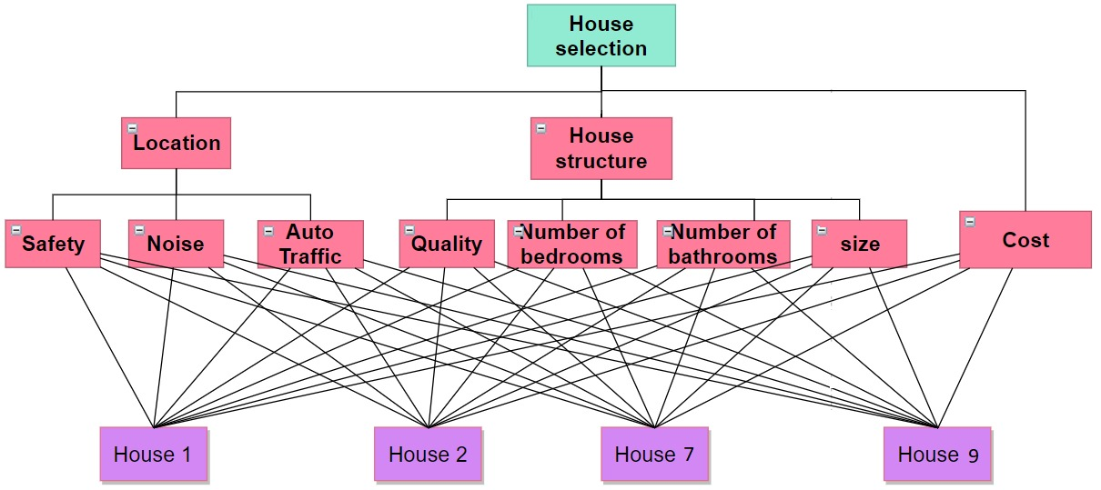
Hierarchy tree

Slide 10
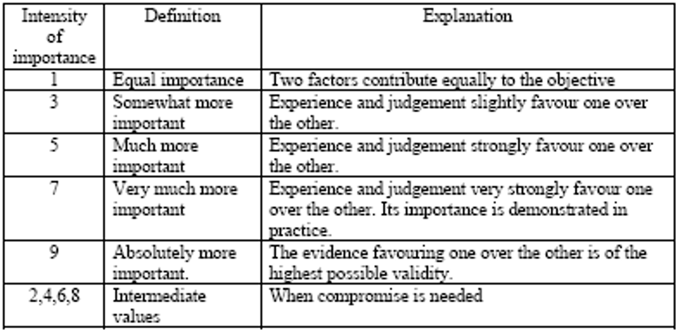
Ranking Scale for Criteria

Slide 11
Ranking Scale for Criteria pairwise comparisons
 | Safety | Noise | Auto traffic | Quality | No. bedrooms | No. bathrooms | Size | Cost
Safety | 1.00 | 5.00 | 5.00 | 0.33 | 3.00 | 3.00 | 1.00 | 0.33
Noise | 0.20 | 1.00 | 1.00 | 0.14 | 0.33 | 0.33 | 0.20 | 0.14
Auto traffic | 0.20 | 1.00 | 1.00 | 0.14 | 0.33 | 0.33 | 0.20 | 0.14
Quality | 3.00 | 7.00 | 7.00 | 1.00 | 5.00 | 5.00 | 3.00 | 1.00
No. bedrooms | 0.33 | 3.00 | 3.00 | 0.20 | 1.00 | 1.00 | 0.33 | 0.20
No. bathrooms | 0.33 | 3.00 | 3.00 | 0.20 | 1.00 | 1.00 | 0.33 | 0.20
Size | 1.00 | 5.00 | 5.00 | 0.33 | 3.00 | 3.00 | 1.00 | 0.33
Cost | 3.00 | 7.00 | 7.00 | 1.00 | 5.00 | 5.00 | 3.00 | 1.00

Slide 12
CALCULATIONS
A^2 |  |  |  |  |  |  |  | Row Sums | Eo
8.000 | 42.667 | 42.667 | 3.962 | 18.667 | 18.667 | 8.000 | 3.962 | 146.590 | 0.133
1.879 | 8.000 | 8.000 | 0.838 | 3.962 | 3.962 | 1.879 | 0.838 | 29.359 | 0.027
1.879 | 8.000 | 8.000 | 0.838 | 3.962 | 3.962 | 1.879 | 0.838 | 29.359 | 0.027
18.133 | 88.000 | 88.000 | 8.000 | 42.667 | 42.667 | 18.133 | 8.000 | 313.600 | 0.284
3.733 | 18.133 | 18.133 | 1.879 | 8.000 | 8.000 | 3.733 | 1.879 | 63.492 | 0.057
3.733 | 18.133 | 18.133 | 1.879 | 8.000 | 8.000 | 3.733 | 1.879 | 63.492 | 0.057
8.000 | 42.667 | 42.667 | 3.962 | 18.667 | 18.667 | 8.000 | 3.962 | 146.590 | 0.133
18.133 | 88.000 | 88.000 | 8.000 | 42.667 | 42.667 | 18.133 | 8.000 | 313.600 | 0.284

Slide 13
CALCULATIONS
(A^2)^2 |  |  |  |  |  |  |  | Row Sums | E1=X=Weight | D
571.435 | 2739.606 | 2739.606 | 268.461 | 1273.498 | 1273.498 | 571.435 | 268.461 | 9706.003 | 0.131 | -0.001
120.117 | 579.562 | 579.562 | 56.603 | 268.461 | 268.461 | 120.117 | 56.603 | 2049.486 | 0.028 | 0.001
120.117 | 579.562 | 579.562 | 56.603 | 268.461 | 268.461 | 120.117 | 56.603 | 2049.486 | 0.028 | 0.001
1229.613 | 5910.756 | 5910.756 | 579.562 | 2739.606 | 2739.606 | 1229.613 | 579.562 | 20919.074 | 0.282 | -0.001
255.783 | 1229.613 | 1229.613 | 120.117 | 571.435 | 571.435 | 255.783 | 120.117 | 4353.896 | 0.059 | 0.001
255.783 | 1229.613 | 1229.613 | 120.117 | 571.435 | 571.435 | 255.783 | 120.117 | 4353.896 | 0.059 | 0.001
571.435 | 2739.606 | 2739.606 | 268.461 | 1273.498 | 1273.498 | 571.435 | 268.461 | 9706.003 | 0.131 | -0.001
1229.613 | 5910.756 | 5910.756 | 579.562 | 2739.606 | 2739.606 | 1229.613 | 579.562 | 20919.074 | 0.282 | -0.001

Slide 14
CALCULATIONS
Weight from AHP
Ideal alternative J
Negative ideal alternative J'
 | Location |  |  | House structure |  |  |  | Cost
 | Safety | Noise | Auto traffic | Quality | No. bedrooms | No. bathrooms | Size
House 1 | 8 | 4 | 4 | 5 | 5 | 4 | 3 | 3
House 2 | 6 | 5 | 4 | 6 | 6 | 4 | 4 | 5
House 7 | 4 | 6 | 5 | 9 | 7 | 5 | 7 | 6
House 9 | 3 | 7 | 6 | 8 | 6 | 6 | 8 | 8
weights | 0.131 | 0.028 | 0.028 | 0.282 | 0.059 | 0.059 | 0.131 | 0.282

Slide 15

CALCULATIONS
TOPSIS | Location |  |  | House structure |  |  |  | Cost
Vij | Safety | Noise | Auto traffic | Quality | No. bedrooms | No. bathrooms | Size
House 1 | 0.094 | 0.010 | 0.012 | 0.098 | 0.024 | 0.024 | 0.033 | 0.073
House 2 | 0.070 | 0.012 | 0.012 | 0.118 | 0.029 | 0.024 | 0.045 | 0.122
House 7 | 0.047 | 0.015 | 0.015 | 0.177 | 0.034 | 0.031 | 0.078 | 0.146
House 9 | 0.035 | 0.017 | 0.017 | 0.157 | 0.029 | 0.037 | 0.089 | 0.195
A* (ideal solution) | 0.094 | 0.010 | 0.012 | 0.177 | 0.034 | 0.037 | 0.089 | 0.073
A’ (negative ideal solution) | 0.035 | 0.017 | 0.017 | 0.098 | 0.024 | 0.024 | 0.033 | 0.195
The rank from the best to the worst is: House 1,House 7,House 2,House 9
S* | S' | C*
0.098 | 0.135 | 0.581
0.093 | 0.085 | 0.478
0.088 | 0.104 | 0.542
0.137 | 0.082 | 0.375
TOPSIS selects the alternative that is the closest to the ideal solution and farthest from negative ideal alternative.

Slide 16
CONCULSION
by APH & TOPSIS methodology we select the best house, from AHP we create the hierarchy tree and rank criteria, then get the weight for each one to use it in TOPSIS method. By TOPSIS we select the most ideal alternative as the ideal.
The rank of houses starting from the best is: House 1,House 7,House 2,House 9.

